Slide 1
Final Project
Daniel Brunell, Brett Nielsen, Katelynn Call

Slide 2
Overview and goals
Show how soil water level and soil temperature affects low vegetation.
Show how these values have changed over time.
Make a program that would be easily useable by people who have little experience with visualization tools.

Slide 3
Description of the data used
Climate Data: ERA5-Land Hourly Data - https://cds.climate.copernicus.eu/
Has data from 1981-2020
Can choose from various types of data to be put into either a GRIB or NetCDF
Can specify dates up to the hour to choose from(ex 1985 May, 4 at 1PM)
Data we chose:
Volumetric Soil Water Layer 1
Soil Temperature Level 1
Leaf Area Index, Low Vegetation
Chose to focus on the data from May 1st at 12:00 every 5 years from 1990-2020

Slide 4
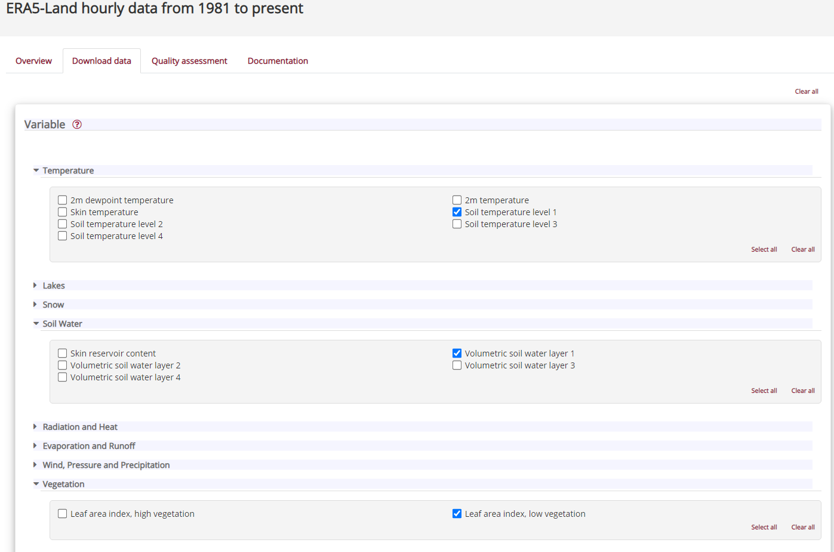
CDS Data Retrieval

Slide 5
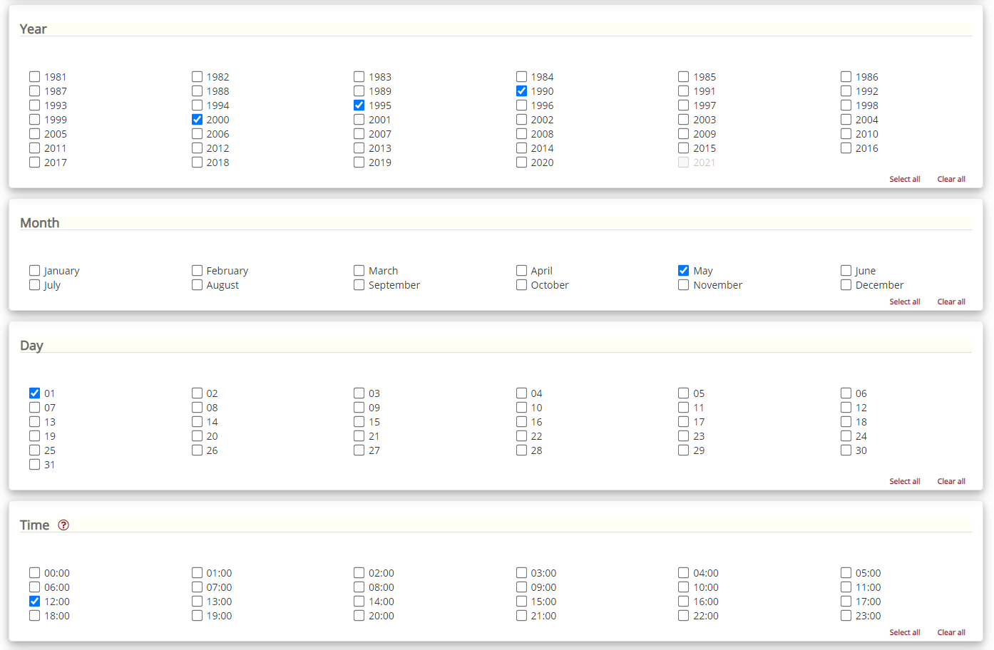
CDS Data Retrieval (cont.)

Slide 6
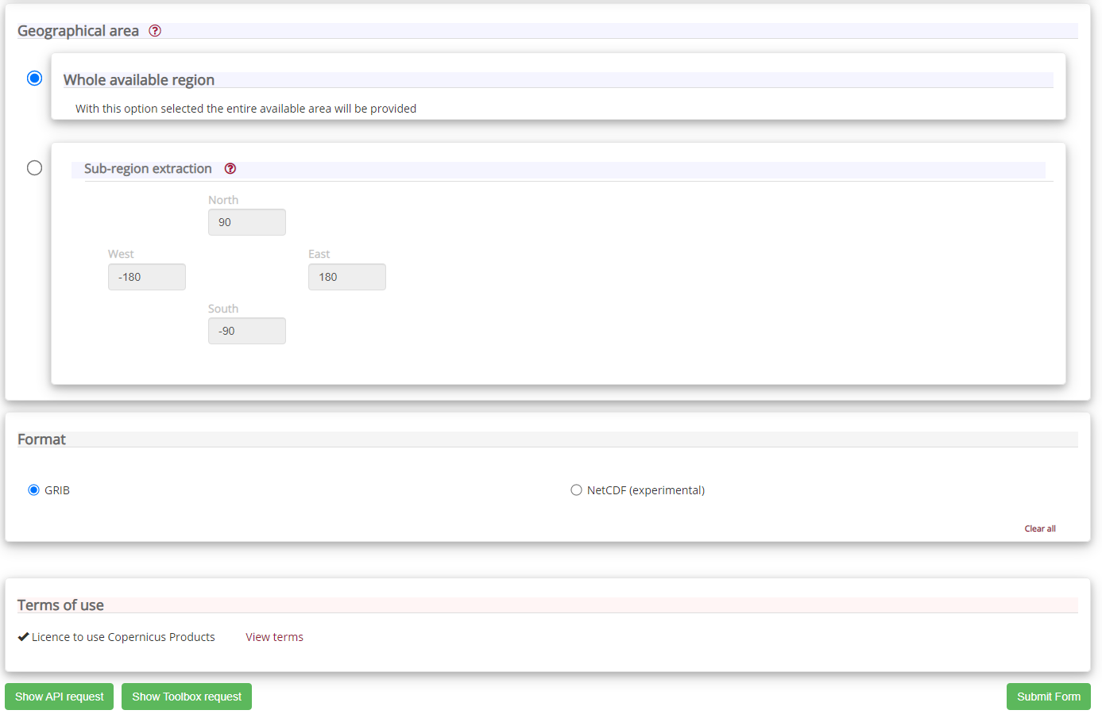
CDS Data Retrieval (cont.)

Slide 7
Tools/libraries that we used
Python - Programming Base
Xarray - To transform our GRIB data files into something we can use
ecCodes - Library for reading GRIB data (used by the xarray library)
Cartopy - To Visualize our data
PySimpleGui - For a user friendly GUI

Slide 8
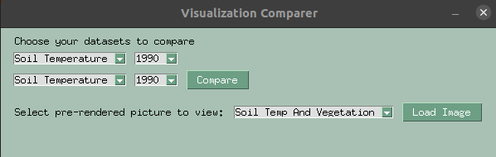
Description of our solution
Our GUI before any rendering has taken place

Slide 9
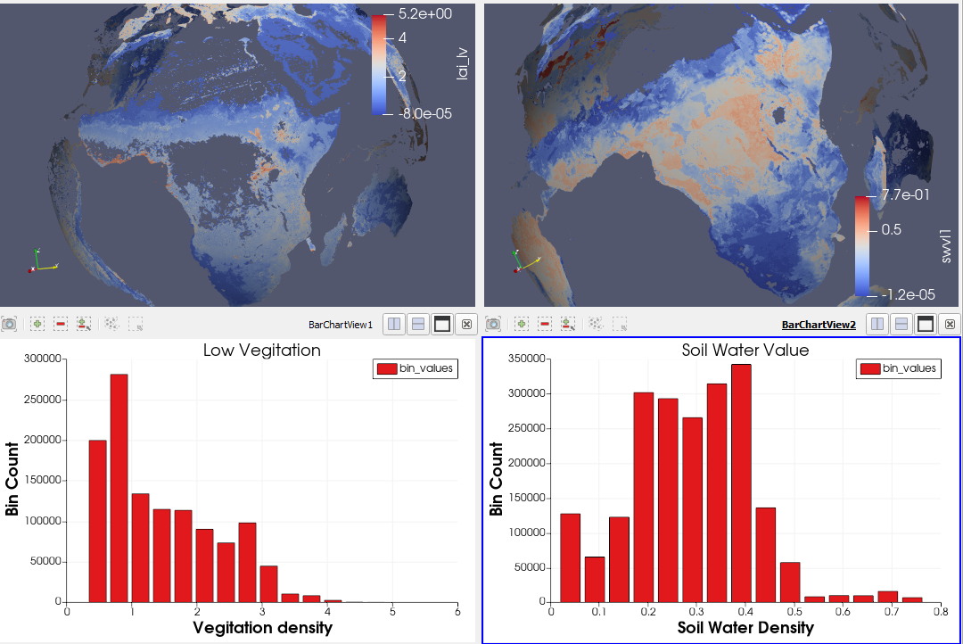
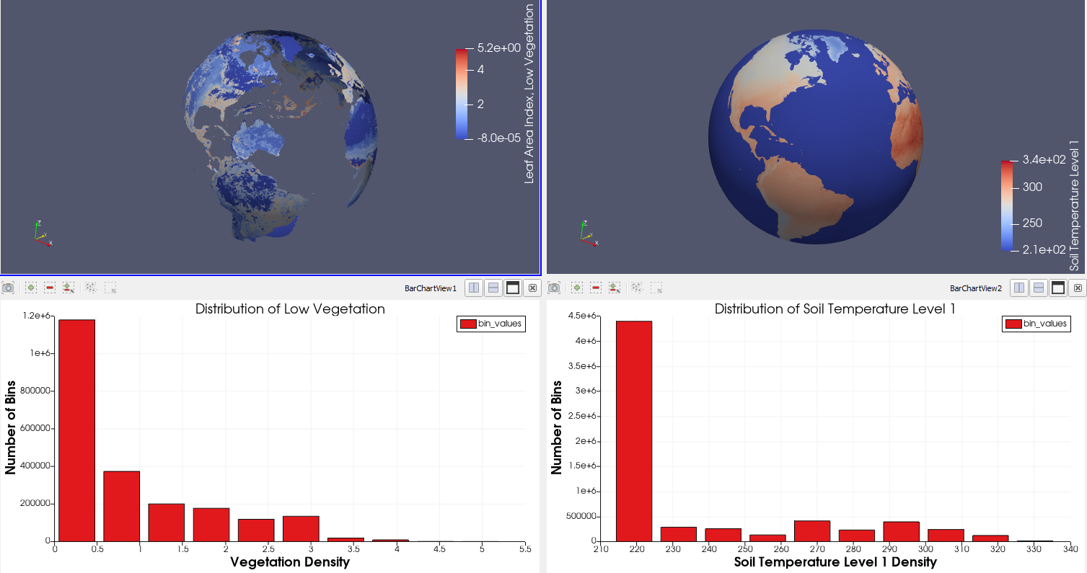
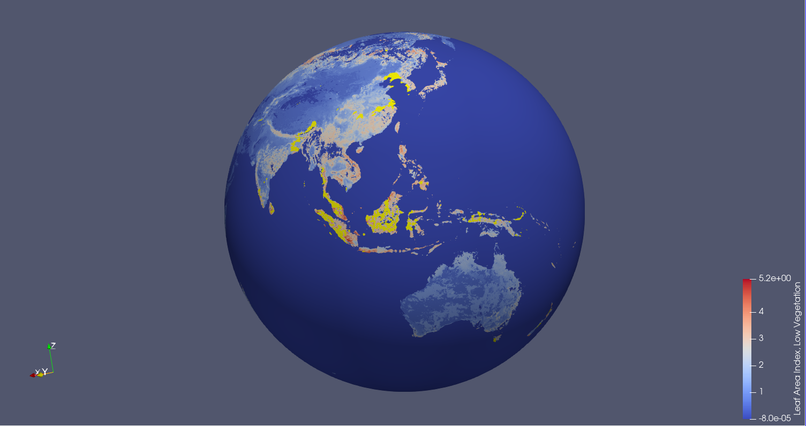
Paraview Visualizations

Slide 10
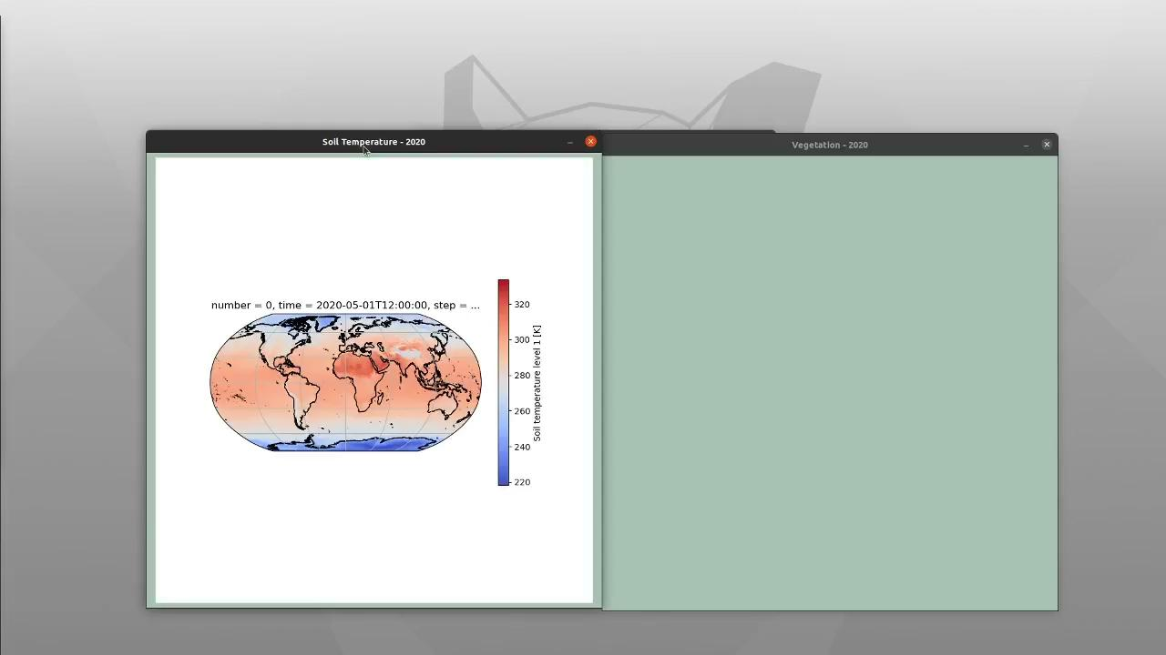
Demo

Slide 11
Challenges
Sheer size of the data we were using
60 MB for seven data time points with only three types of data
Converting the data into something we could use (more on next slide)
Multi-platform usability
Had to use a Conda environment to work on windows(unstable)

Slide 12
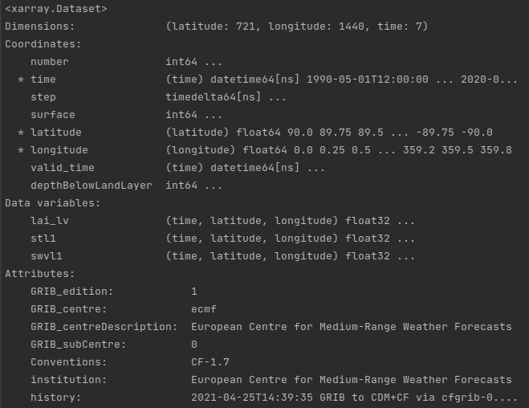
Challenges - GRIB Data
Needed to learn what GRIB files are and how to read them
GRIB files are used to store meteorological data
Contains information by latitude, longitude, altitude, and time
2 versions of GRIB files that use different methods to read
We used ecCodes Library as recommended by the provider of the data set
ecCodes does not officially support Windows

Slide 13
Changes we had to make to our initial plan
Initially wanted to have many different types of data included, about 8 different types.
Because of the sheer size of the files we either had to have a shorter range of dates or less data, we chose to focus more on specific data in order to see the change in time better.
We originally planned on using VTK for visualizations
We decided to use Cartopy to create the visualizations instead
Allowed for easy to understand visualizations on top of maps

Slide 14
Future Improvements
More data points for visualizations
Be able to add/load other data sets more easily with a file browser
Decrease the amount of time it takes to load a visualization
Fully support all operating systems

